Slide 1
Entity-Relationship Model (Quiz-01 Short Syllabus)
Modified by
Shadman Rabby
Lecturer, Dept. of CSE, Daffodil Internatioal University
Created by
Professor Dr. K. M. Azharul Hasan
Dept. of CSE, KUET

Slide 2
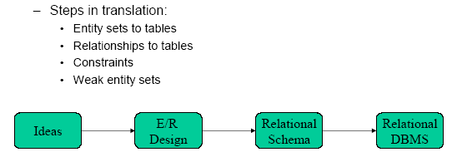
Entity-Relationship Model
An entity relationship diagram (ERD) is a representation of data within a domain. It consists of entities as well as relationships between entities.
A graphical representation of entities and their relationships to each other
A logical data model of the real world.

Slide 3
Modeling
A database can be modeled as:
a collection of entities,
relationship among entities.
An entity is an object that exists and is distinguishable from other objects.
Example: specific person, company, event, plant
Entities have attributes
Example: people have names and addresses
An entity set is a set of entities of the same type that share the same properties.
Example: set of all persons, companies, trees, holidays

Slide 4
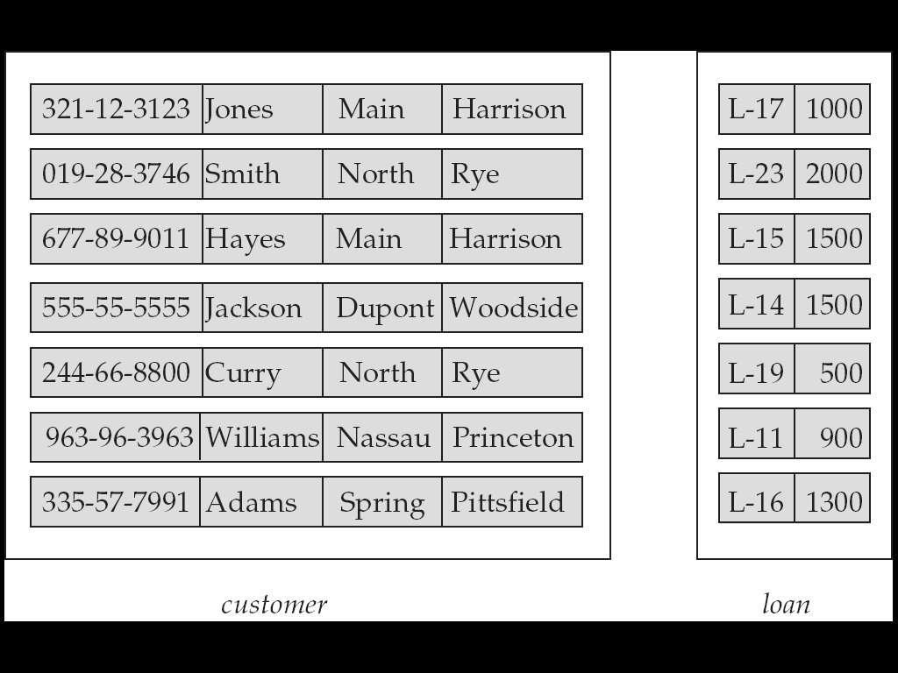
Entity Sets customer and loan
customer_id customer_ customer_ customer_ loan_ amount name street city number

Slide 5
Attributes
An entity is represented by a set of attributes, that is descriptive properties possessed by all members of an entity set.
Domain – the set of permitted values for each attribute
Example: customer = (customer_id, customer_name, customer_street, customer_city ) loan = (loan_number, amount )

Slide 6
Attribute types:
Simple attributes: Student_Id
composite attributes : Street (street can be further devided into street no, street_name etc.
Single-valued and multi-valued attributes
Example: multi valued attribute: phone_numbers
Derived attributes
Can be computed from other attributes
Example: age, given date_of_birth

Slide 7
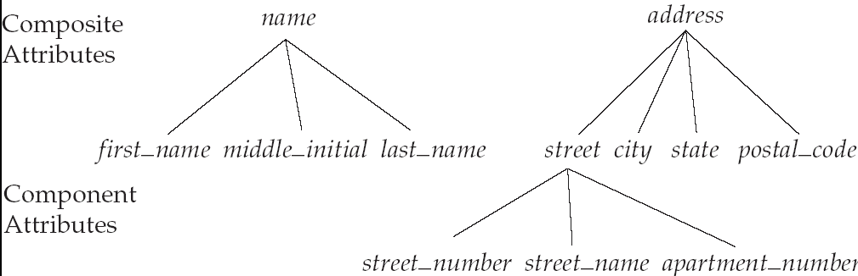
Composite Attributes

Slide 8
Relationship Sets
A relationship is an association among several entities
Example: Hayes depositor A-102 customer entity relationship set account entity
A relationship set is a mathematical relation among n ≥ 2 entities, each taken from entity sets
{(e₁, e₂, … e_{n}) | e₁ ∈ E₁, e₂ ∈ E₂, …, e_{n} ∈ E_{n}} where (e₁, e₂, …, e_{n}) is a relationship
Example:
(Hayes, A-102) ∈ depositor

Slide 9
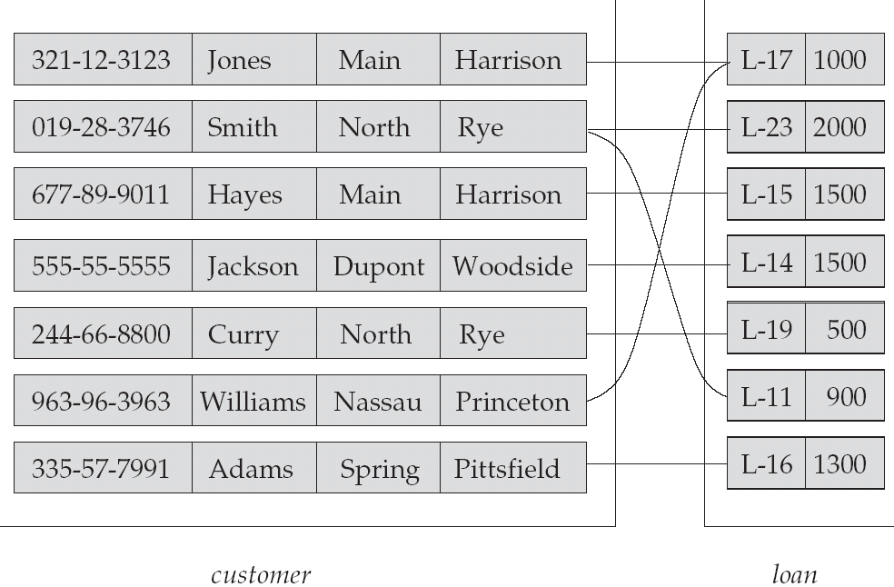
Relationship Set borrower

Slide 10
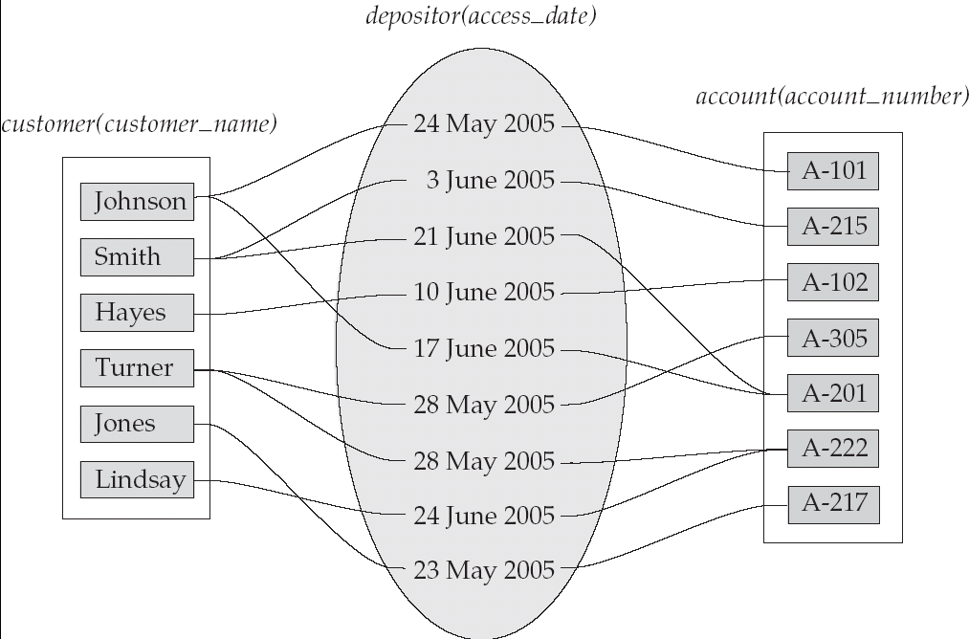
Relationship Sets (Cont.)
An attribute can also be property of a relationship set.
For instance, the depositor relationship set between entity sets customer and account may have the attribute access-date

Slide 11
Degree of a Relationship Set
Refers to number of entity sets that participate in a relationship set.
Relationship sets that involve two entity sets are binary (or degree two). Generally, most relationship sets in a database system are binary.
Relationships between more than two entity sets are rare. Most relationships are binary.

Slide 12
Mapping Cardinality Constraints
Number of entities to which another entity can be associated via a relationship set.
Most useful in describing binary relationship sets.
For a binary relationship set the mapping cardinality must be one of the following types:
One to one
One to many
Many to one
Many to many

Slide 13
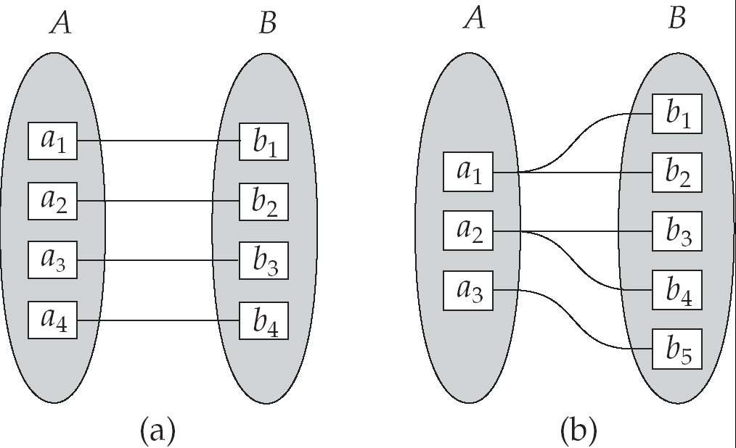
Mapping Cardinalities
One to one
One to many

Slide 14
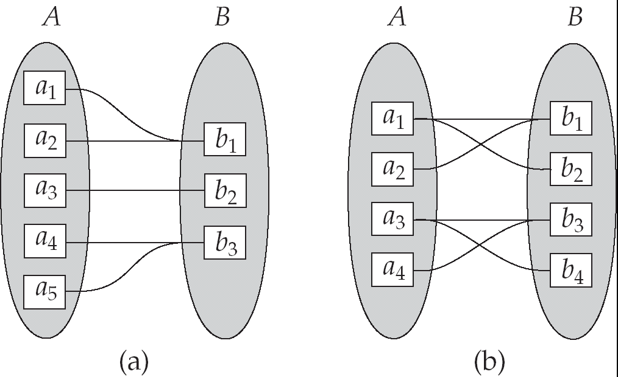
Mapping Cardinalities
Many to one
Many to many

Slide 15
Keys
A super key of an entity set is a set of one or more attributes whose values uniquely determine each entity.
A candidate key of an entity set is a minimal super key
Customer_id is candidate key of customer
account_number is candidate key of account
Although several candidate keys may exist, one of the candidate keys is selected to be the primary key.

Slide 16
Keys for Relationship Sets
The combination of primary keys of the participating entity sets form a super key of a relationship set.
(customer_id, account_number) is the super key of depositor
Must consider the mapping cardinality of the relationship set when deciding what are the candidate keys

Slide 17
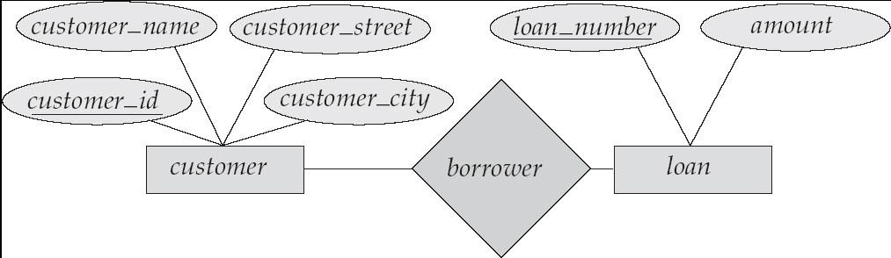
E-R Diagrams
Rectangles represent entity sets.
Diamonds represent relationship sets.
Lines link attributes to entity sets and entity sets to relationship sets.
Ellipses represent attributes
Double ellipses represent multivalued attributes.
Dashed ellipses denote derived attributes.
Underline indicates primary key attributes

Slide 18
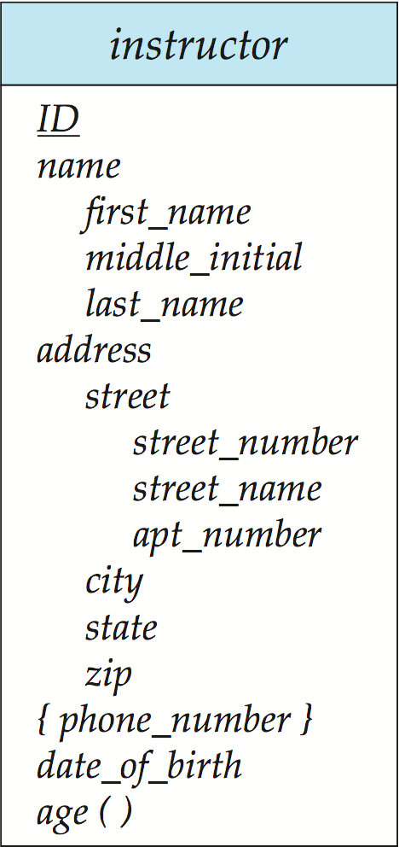
Entity With Composite, Multivalued, and Derived Attributes

Slide 19
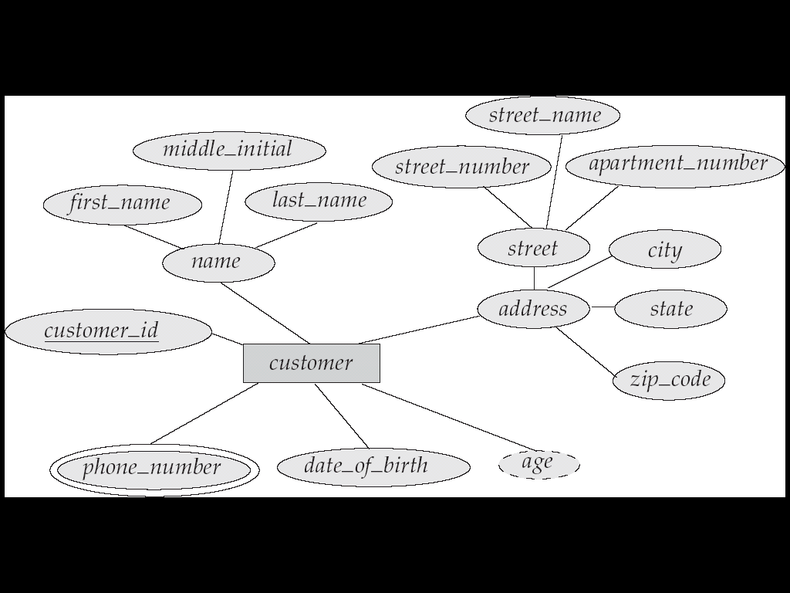
E-R Diagram With Composite, Multivalued, and Derived Attributes

Slide 20
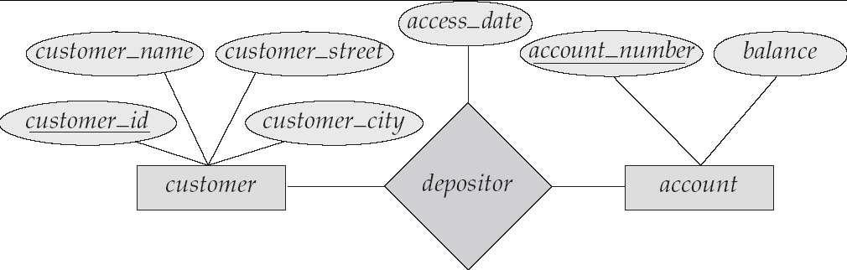
Relationship Sets with Attributes

Slide 21
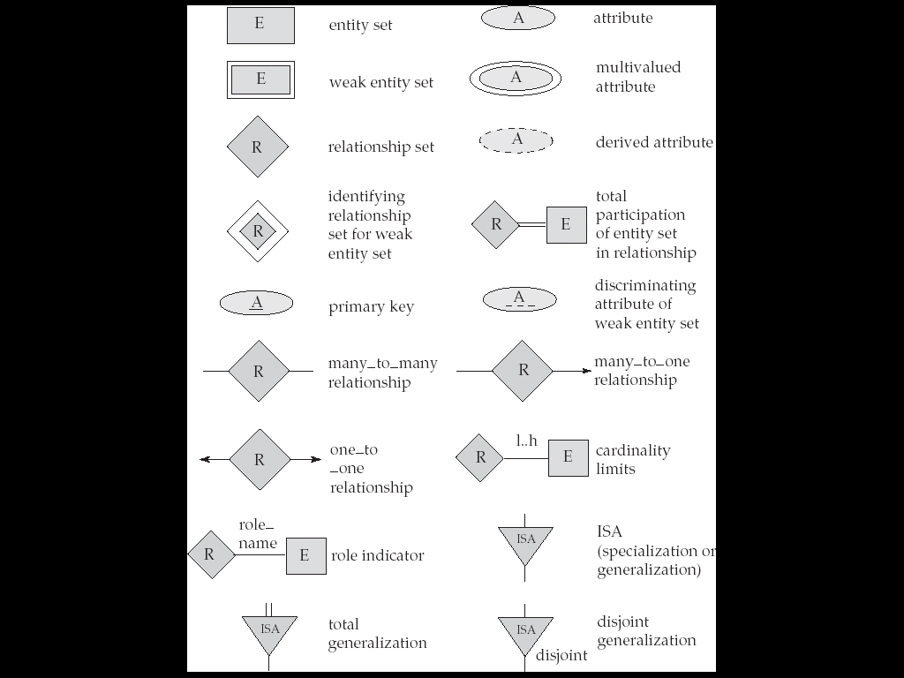
Summary of Symbols Used in E-R Notation

Slide 22
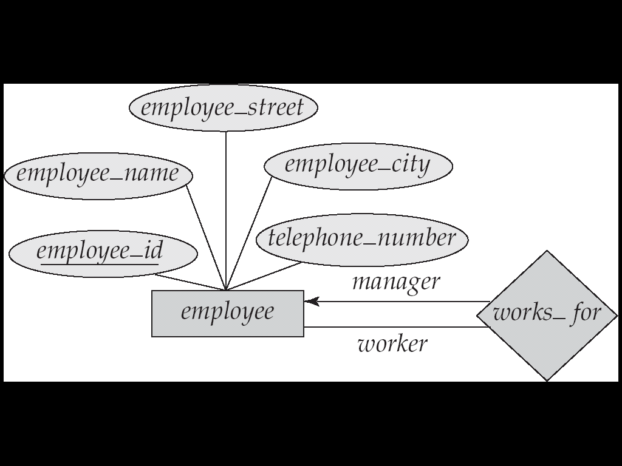
Roles
The function that an entity plays in a relationship is called role.
The labels “manager” and “worker” are called roles; they specify how employee entities interact via the works_for relationship set.
Roles are indicated in E-R diagrams by labeling the lines that connect diamonds to rectangles.
Role labels are optional, and are used to clarify semantics of the relationship

Slide 23
Cardinality Constraints
We express cardinality constraints by drawing either a directed line (→), signifying “one,” or an undirected line (—), signifying “many,” between the relationship set and the entity set.
One-to-one relationship:
A customer is associated with at most one loan via the relationship borrower
A loan is associated with at most one customer via borrower

Slide 24
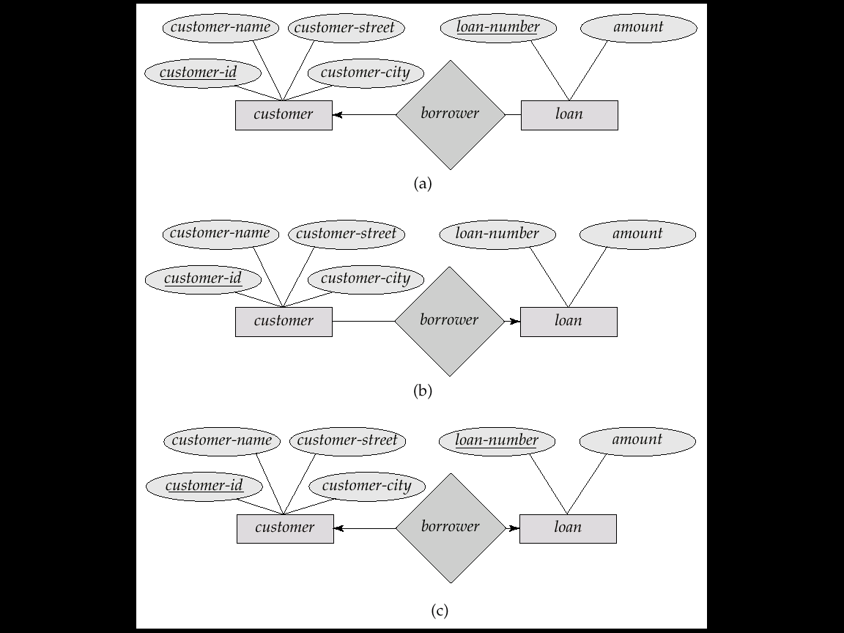
One-To-Many Relationship
In the one-to-many relationship a loan is associated with at most one customer via borrower, a customer is associated with several (including 0) loans via borrower

Slide 25
Many-To-One Relationships
In a many-to-one relationship a loan is associated with several (including 0) customers via borrower, a customer is associated with at most one loan via borrower

Slide 26
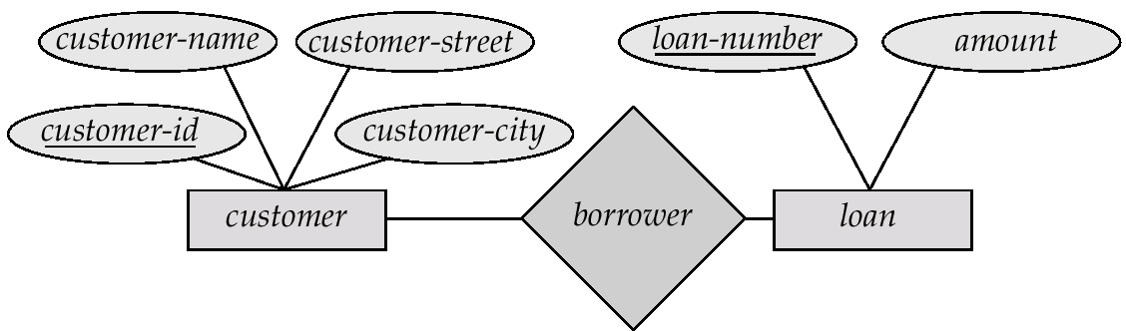
Many-To-Many Relationship
A customer is associated with several (possibly 0) loans via borrower
A loan is associated with several (possibly 0) customers via borrower

Slide 27
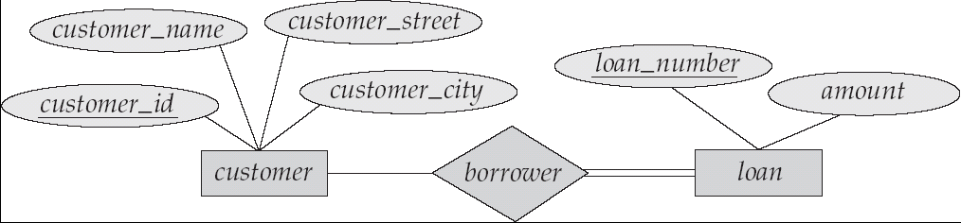
Participation of an Entity Set in a Relationship Set
Total participation (indicated by double line): every entity in the entity set participates in at least one relationship in the relationship set
E.g. participation of loan in borrower is total; every loan must have a customer
Partial participation: some entities may not participate in any relationship in the relationship set
Example: participation of customer in borrower is partial

Slide 28
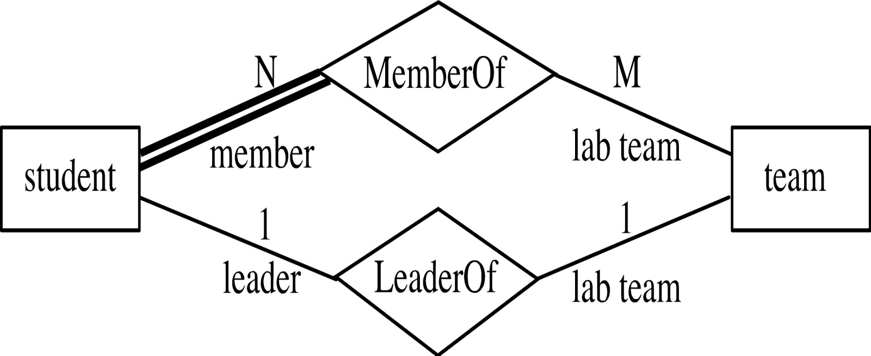
Participation of an Entity Set in a Relationship Set
Every student must be a member of a team
The participation of student in LeaderOf is partial, because only one student might be a team leader.

Slide 29
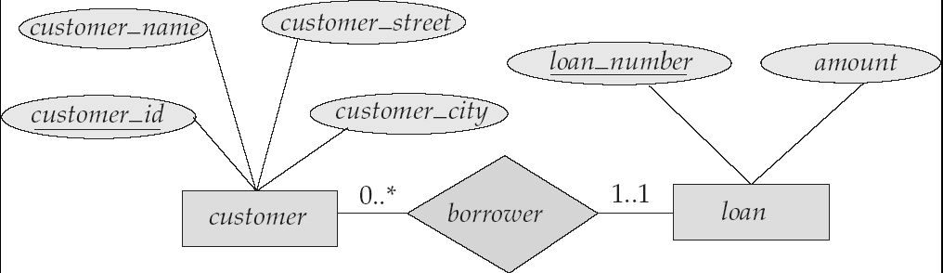
Alternative Notation for Cardinality Limits
Cardinality limits can also express participation constraints

Slide 30
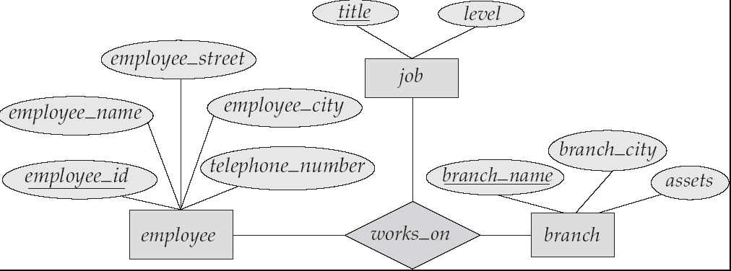
E-R Diagram with a Ternary Relationship

Slide 31
Binary Vs. Non-Binary Relationships
Some relationships that appear to be non-binary may be better represented using binary relationships
E.g. A ternary relationship parents, relating a child to his/her father and mother, is best replaced by two binary relationships, father and mother
Using two binary relationships allows partial information (e.g. only mother being know)
But there are some relationships that are naturally non-binary
Example: works_on

Slide 32
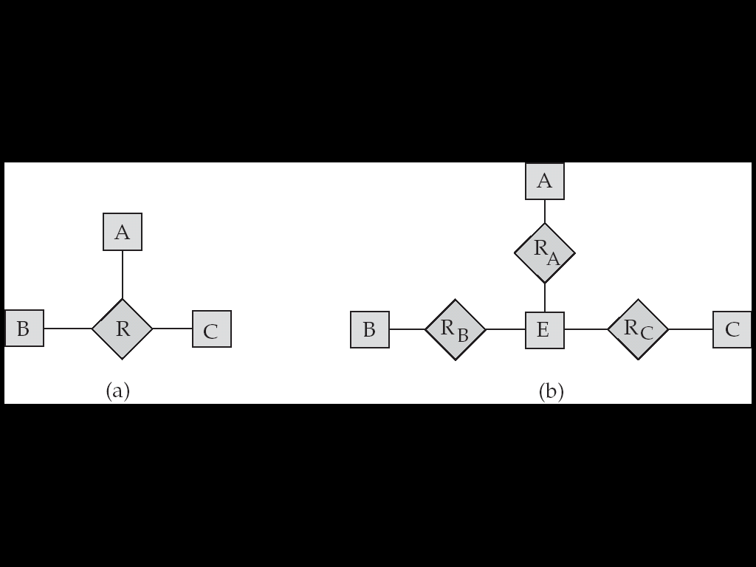
Converting Non-Binary Relationships to Binary Form
In general, any non-binary relationship can be represented using binary relationships by creating an artificial entity set.
Replace R between entity sets A, B and C by an entity set E, and three relationship sets:
1. R_{A}, relating E and A 2.R_{B}, relating E and B
3. R_{C}, relating E and C
Create a special identifying attribute for E
Add any attributes of R to E
For each relationship (a_{i} , b_{i} , c_{i}) in R, create
1. a new entity e_{i} in the entity set E 2. add (e_{i} , a_{i} ) to R_{A}
3. add (e_{i} , b_{i} ) to R_{B} 4. add (e_{i} , c_{i} ) to R_{C}

Slide 33
Binary vs. Ternary Relationships
name
ssn
lot
pname
age
Employees
Covers
Dependents
Bad design
Policies
policyid
cost
name
pname
age
ssn
lot
Dependents
Employees
Purchaser
Beneficiary
Better design
Policies
policyid
cost
Notes:
7

Slide 34
Thank You

